Slide 1


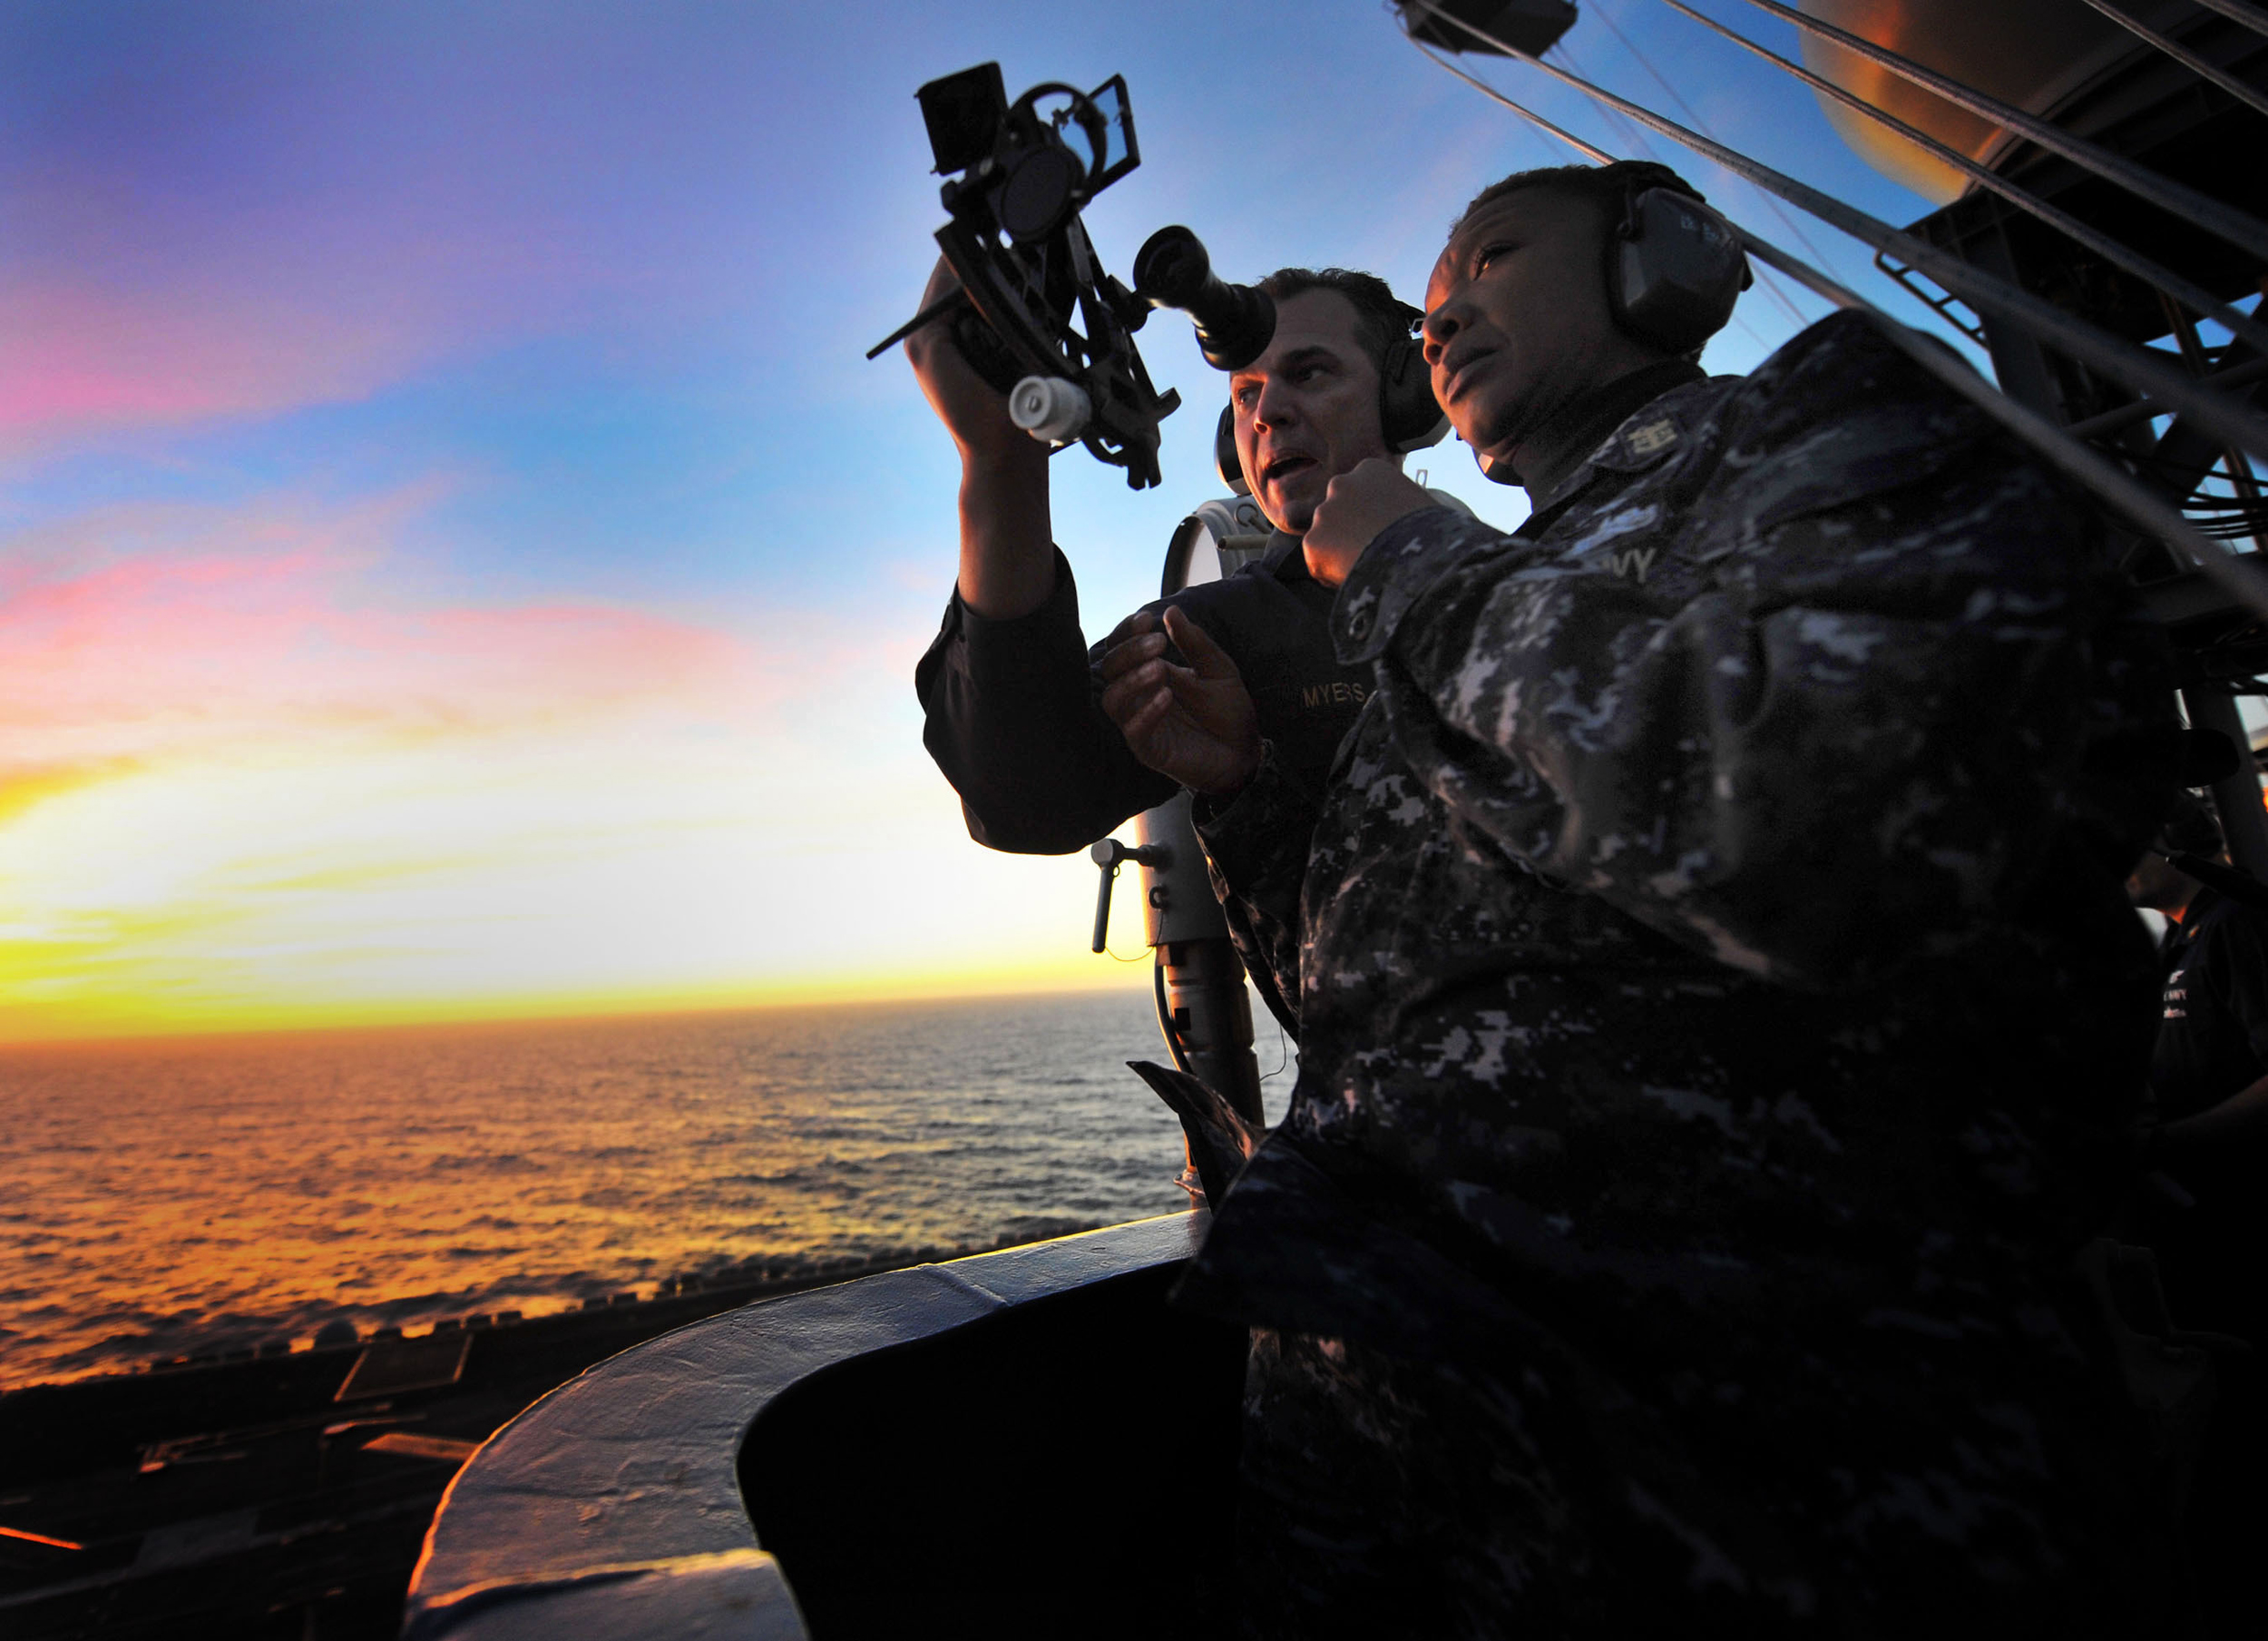
Celestial Day’s Work in Navigation
NN220-14
SEANAV I United States Naval Academy
NN220 – Fundamentals of Navigation– Updated May 2023
Operations Officer I HMS PROTECTOR A173 I The Ice Patrol Ship

Slide 2
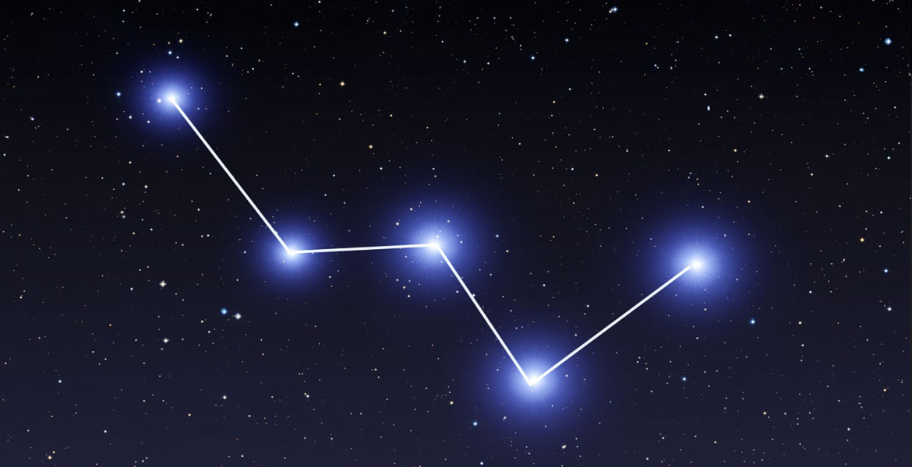
References
-The American Practical Navigator, Pub. No. 9, Bowditch, VOL. 1, 2019 Edition -Surface Ship Navigation Department Organizations and Regulations Manual (NAVDORM), COMNAVSURFPAC/COMNAVAIRPAC/COMNAVAIRLANT/COMNAVSURFLANT INSTRUCTION 3530.4 series -Nautical Almanac
SEANAV I United States Naval Academy
NN220 – Fundamentals of Navigation
Operations Officer I HMS PROTECTOR A173 I The Ice Patrol Ship

Slide 3
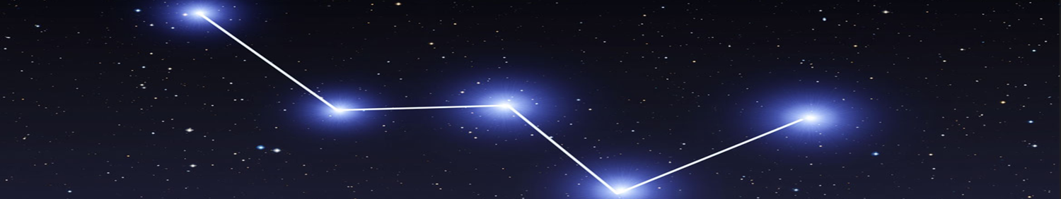
Enabling Objectives
1 – DESCRIBE The planning involved to conduct CELNAV. 2 - DEFINE Local Hour Angle in relation to identifying Celestial Bodies (CBs). 3 - DESCRIBE Dead Reckoning and relationship of Assumed Position (AP) to Time. 4 - EXPLAIN How to identify the best CBs to navigate from. 5 - EXPLAIN Circle of Equal Altitude. 6 - DESCRIBE The Altitude Intercept Method. 7 - DEFINE Sunrise / Sunset in relation to the Visible Horizon. 8 - DESCRIBE The importance of accurate Gyro Compasses and effect on Navigation / Weapon Systems. 9 - EXPLAIN How to calculate Gyro Error from the bearing of Sunrise / Sunset. 10 - DESCRIBE How to fix from the Sun using a Running Fix (Sun Run Sun). 11 - DESCRIBE Meridian Passage and the calculation of Latitude. 12 - DESCRIBE The Day’s Work in Celestial Navigation.
SEANAV I United States Naval Academy
NN220 – Fundamentals of Navigation
Operations Officer I HMS PROTECTOR A173 I The Ice Patrol Ship

Slide 4
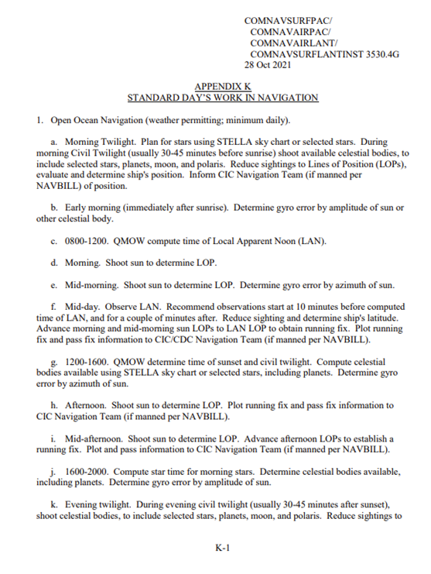
What is the U.S. Navy Policy on CELNAV?
SEANAV I United States Naval Academy
NN220 – Fundamentals of Navigation
Operations Officer I HMS PROTECTOR A173 I The Ice Patrol Ship

Slide 5
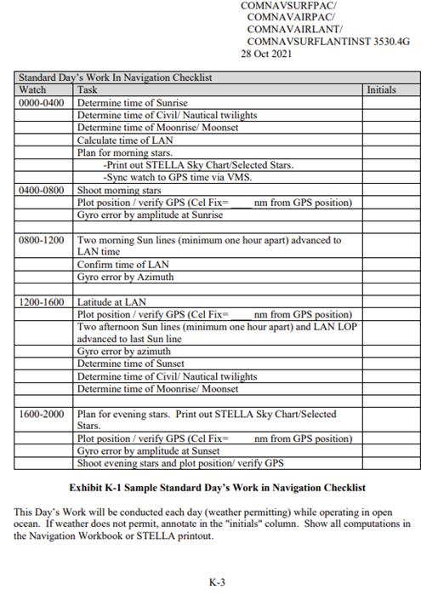
What is the U.S. Navy Policy on CELNAV?
SEANAV I United States Naval Academy
NN220 – Fundamentals of Navigation
Operations Officer I HMS PROTECTOR A173 I The Ice Patrol Ship

Slide 6
What is the U.S. Navy Policy on CELNAV?
-Per the NAVDORM, Celestial Navigation must be conducted, weather permitting, every day in Open Ocean.
-This means that CELNAV is being conducted around the world by ALL surface ships IAW NAVDORM.
-We must familiarize ourselves with the process, commonly called a Celestial’s Days Work in Navigation.
SEANAV I United States Naval Academy
NN220 – Fundamentals of Navigation
Operations Officer I HMS PROTECTOR A173 I The Ice Patrol Ship

Slide 7
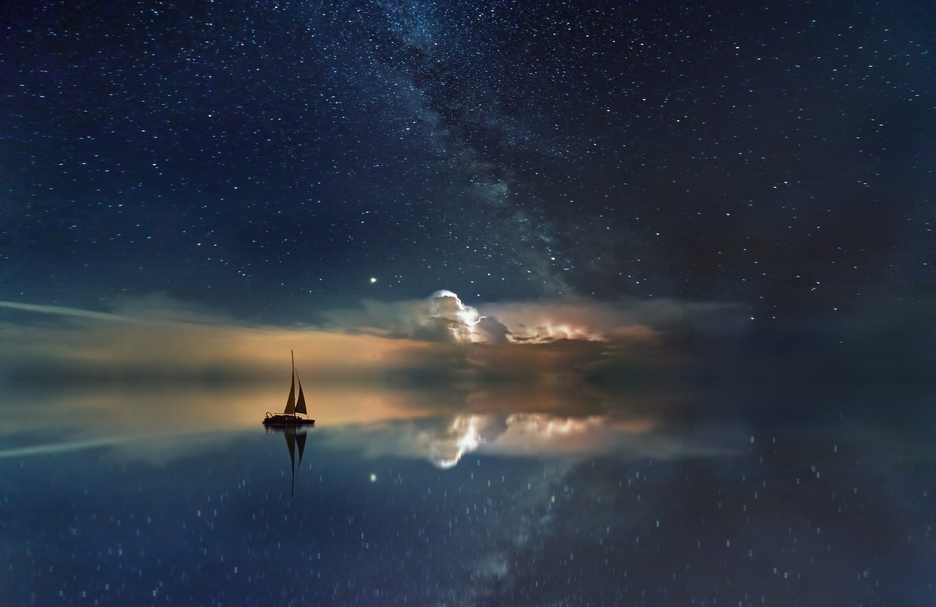
Celestial Navigation
-In the modern navigation era with GPS positioning, CELNAV is primarily used to verify the accuracy of GPS in Open Ocean and equipment accuracy.
-It also doubles as practical experience in sight reductions and celestial fix calculations for bridge watchstanders and Junior Officers.
-It provides an effective fallback should GPS fail or be denied while in Open Ocean transits.
-It is an essential skillset for a mariner.
SEANAV I United States Naval Academy
NN220 – Fundamentals of Navigation
Operations Officer I HMS PROTECTOR A173 I The Ice Patrol Ship

Slide 8
Celestial Navigation
-Many ships will conduct Trans-Oceanic voyages only by fixing celestial positions.
-Within sight of land, the ship will receive it’s last fix by GPS, Visual or RADAR means.
-From there, with an Assumed Position (AP) based on their Dead Reckoning (DR), they can conduct CELNAV and update their position with celestial fixes for the entirety of the transit!
-With the NAVDORM policy on Day’s Work in Navigation, we can lay the foundation for how to effectively determine our position using ONLY CELNAV.
SEANAV I United States Naval Academy
NN220 – Fundamentals of Navigation
Operations Officer I HMS PROTECTOR A173 I The Ice Patrol Ship

Slide 9
CELNAV Planning
-Effective CELNAV relies on planning.
-As we discussed previously, the Apparent Movement of Celestial Bodies (CBs) can mean their Geographic Positions (GPs) can move as much as 900kts across the surface of the Earth. That is 1.5nm per minute!
-Using the Horizon Coordinate System, the Altitude (angle between the CB and the visible horizon) and the Azimuth (true bearing from our position to the CB) will change as well.
-Time and our AP become critical factors.
-We need to calculate the time window of Twilight, as this is the time when we can see both our horizon and the best CBs needed for CELNAV.
-With thousands of CBs in the sky, we need the right ones. To do so, we predict its Altitude and Azimuth based on our AP.
SEANAV I United States Naval Academy
NN220 – Fundamentals of Navigation
Operations Officer I HMS PROTECTOR A173 I The Ice Patrol Ship

Slide 10
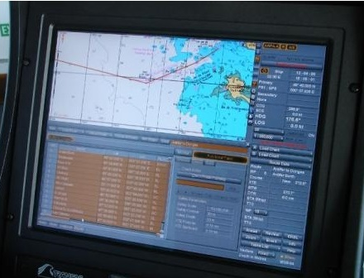
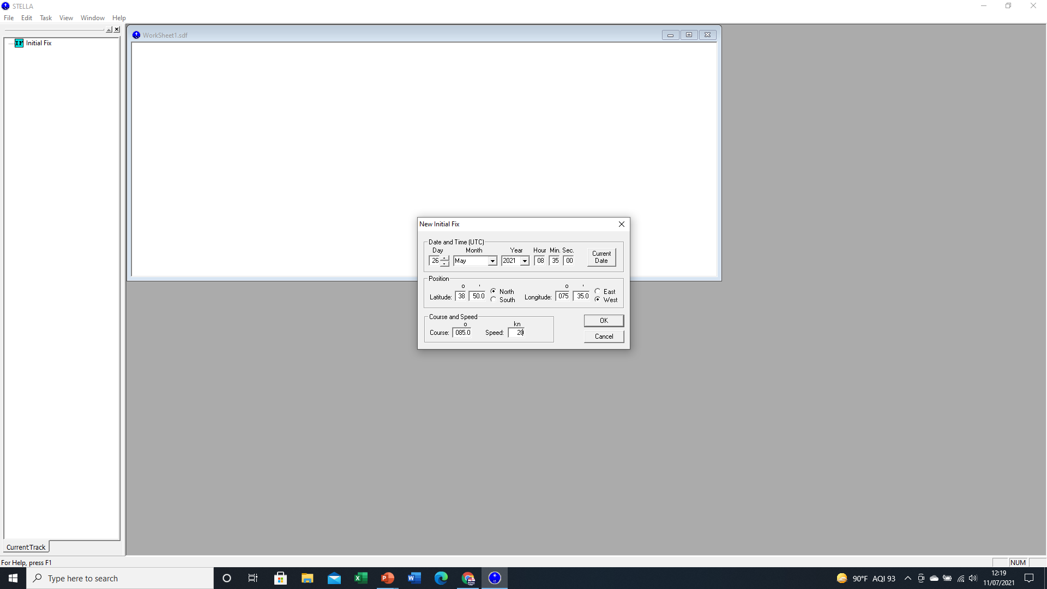
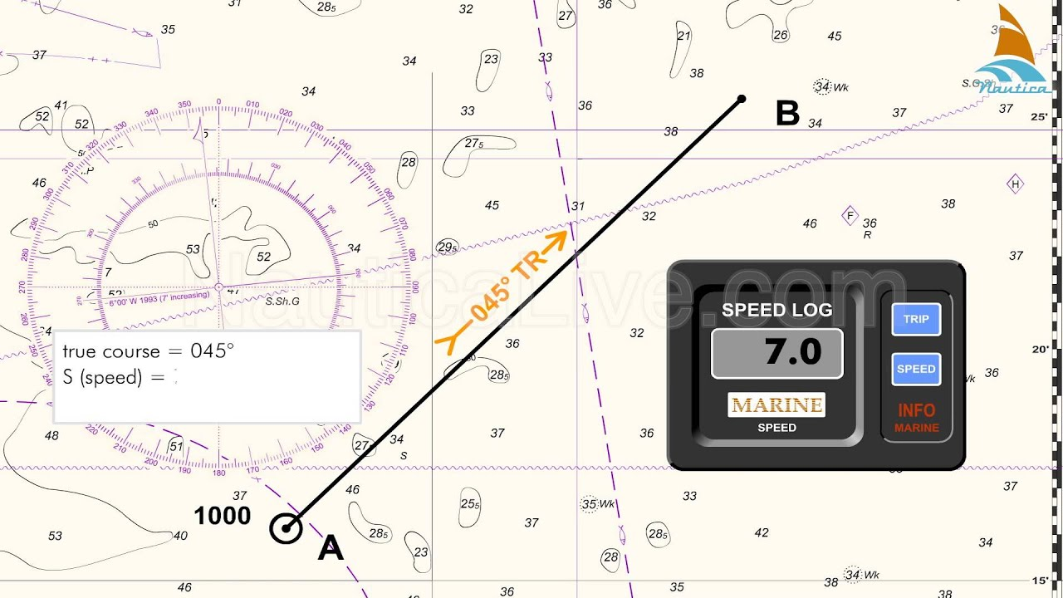
Assumed Position / Dead Reckoning
So how do we predict our position in the future?
ECDIS systems, such as VMS, have a Route Monitoring function. This provides the User with Time information for future positions.
On a paper chart, we draw a line based on our Course from our last fix, and measure distance based on speed to calculate time. This is Dead Reckoning (DR).
Using STELLA, we input an initial Fix as a Latitude and Longitude based on our charted position and the Time. We must input our Course and Speed to enable the software to calculate our position in the future and relate this to Celestial Information.

Slide 11
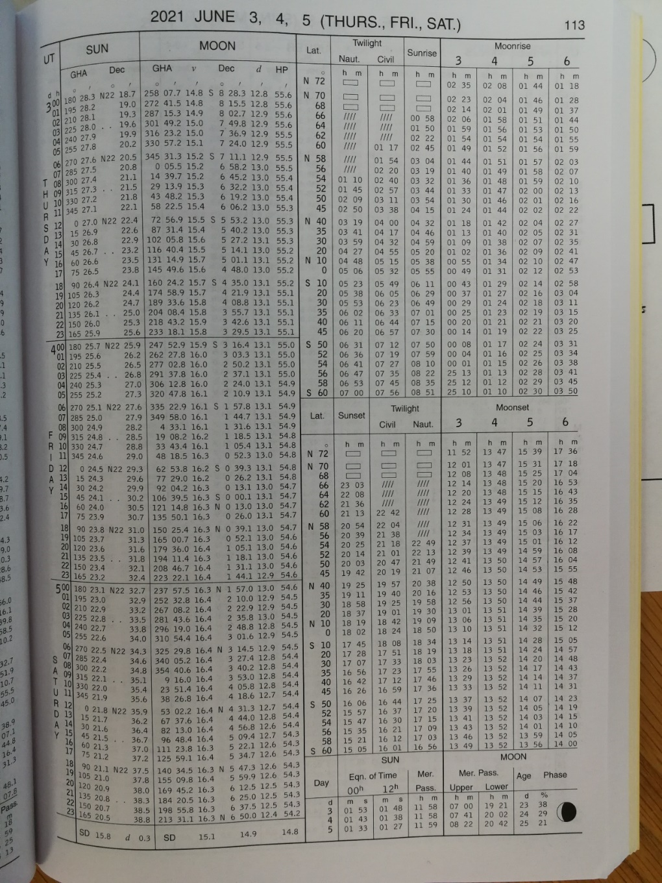

Assumed Position vs Time
We can now predict our Assumed Position (AP) in the future. But remember, the time of day impacts which bodies we can use to navigate.
After Sun Rise, we can see the Visible Horizon, the Sun and sometimes the Moon. We can therefore navigate from these objects.
We can only see Celestial Bodies and the Visible Horizon after Sunset / before Sunrise during the period of Twilight. After this it becomes too dark to see the Visible Horizon.
The Nautical Almanac gives us the Time of Sunrise / Sunset / Civil and Nautical Twilight for every day of the year and every Latitude.

Slide 12
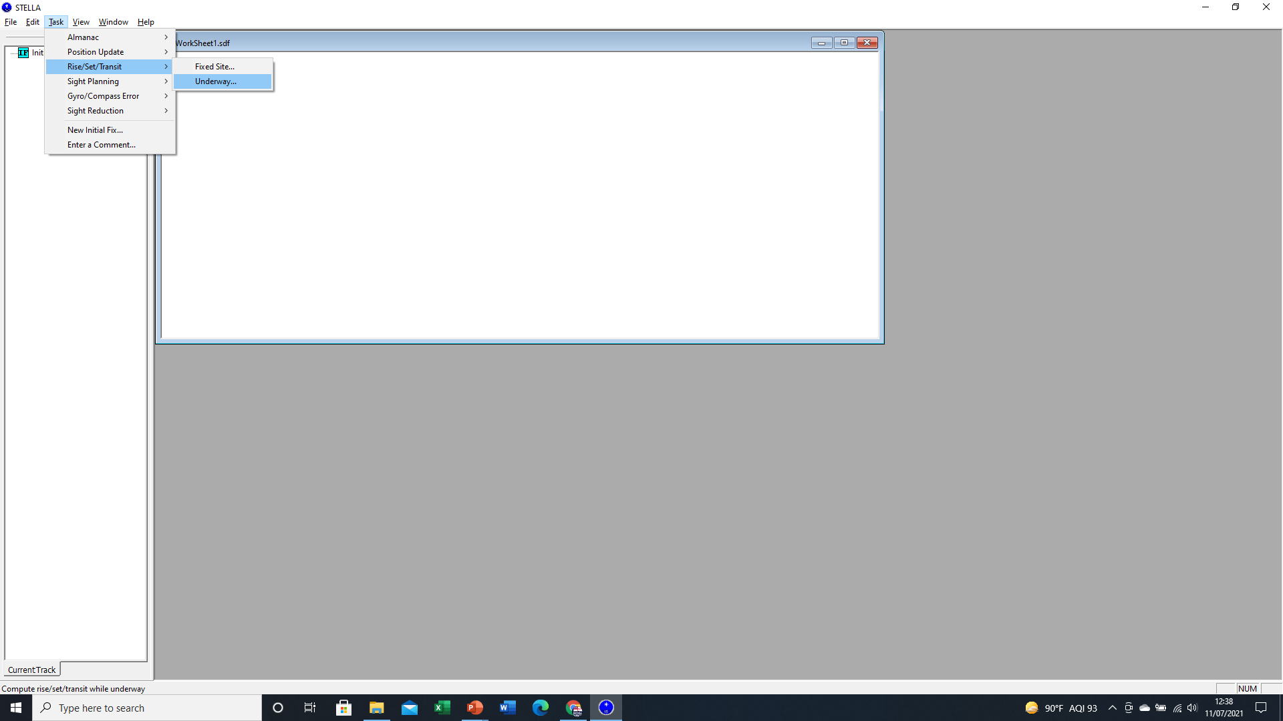
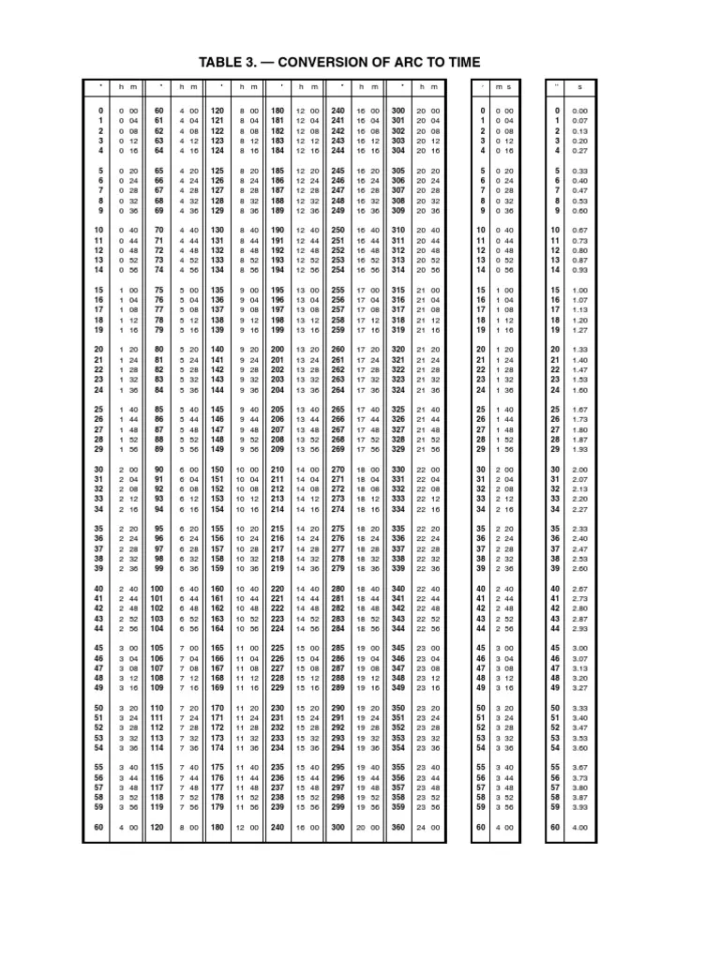
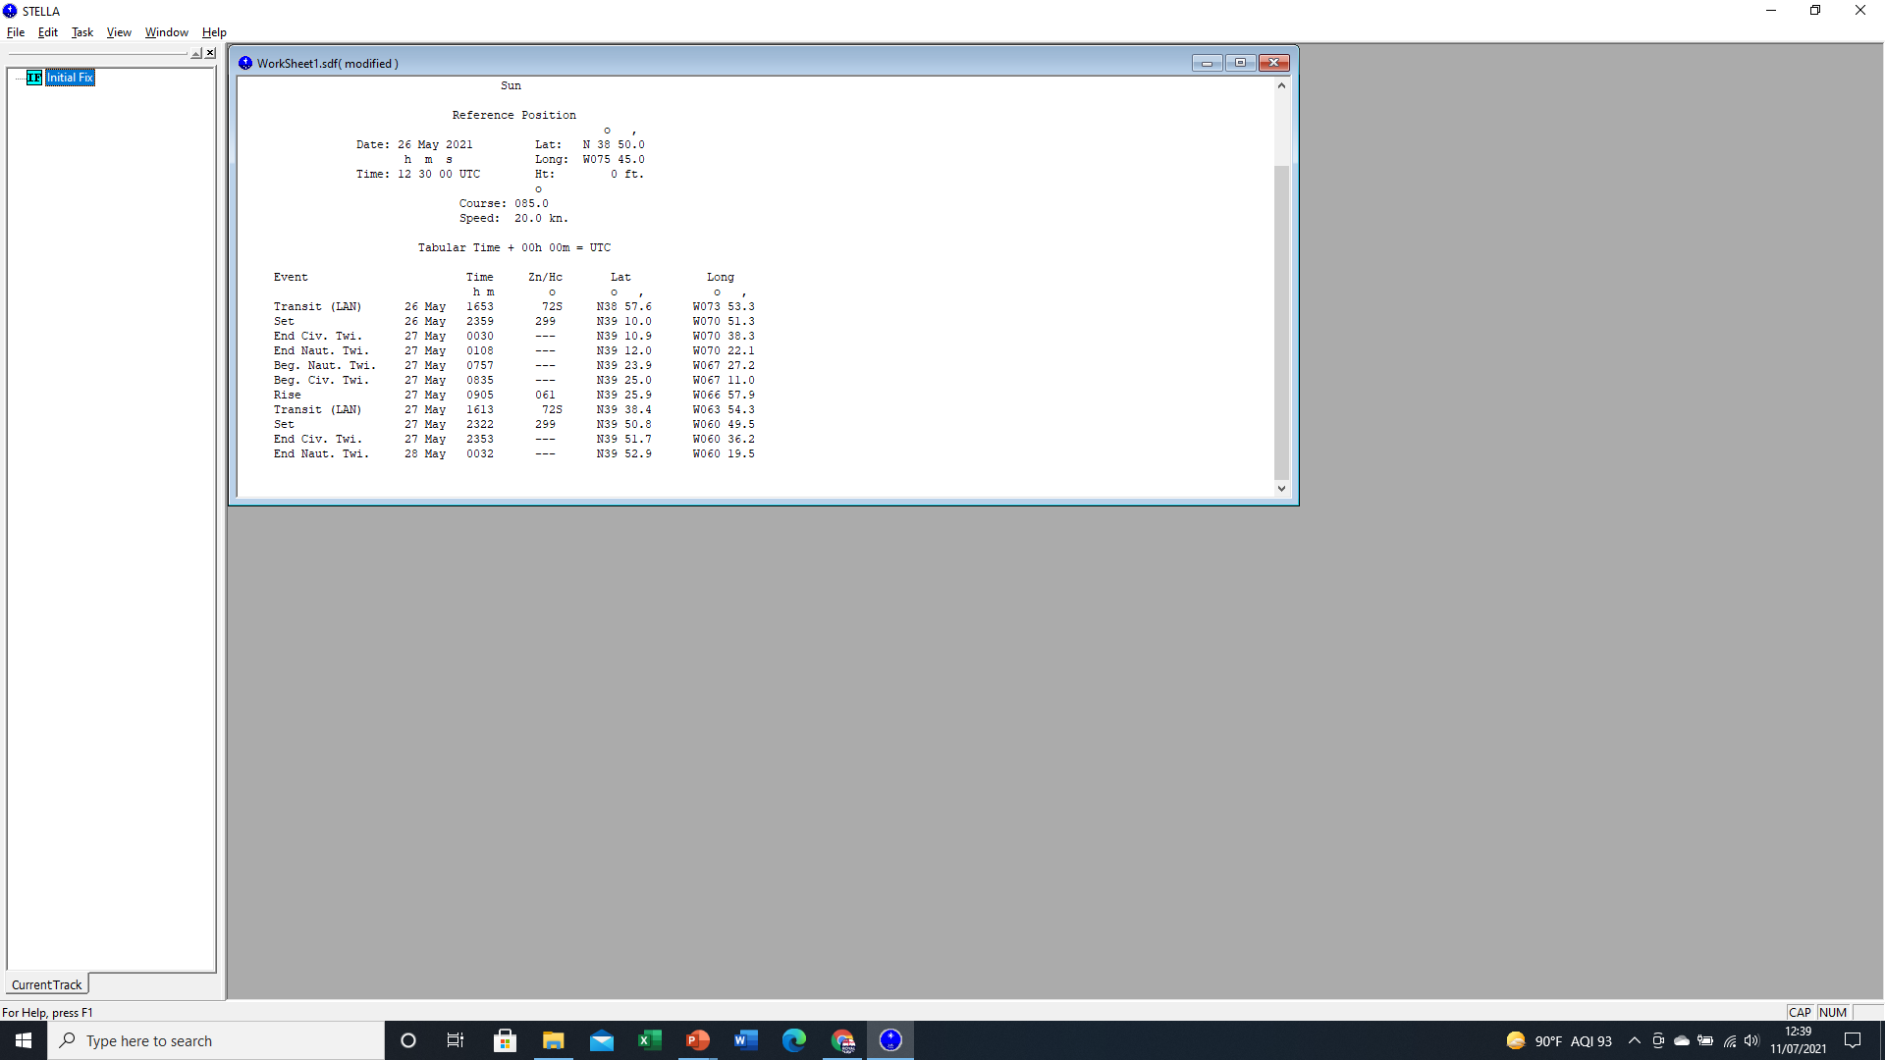
Assumed Position vs Time
So using our AP’s Latitude (DR) we can calculate the Time of SR/SS/Twilight based on the Greenwich Meridian.
However, using our AP, we must then account for our Longitude East or West.
Provides Times associated with DR position
Remembering:
15° of Longitude = 1Hr of Time.
1° of Longitude = 4mins.
Rather than doing the Math, the Nautical Almanac has a useful Arc to Time Table to help us out!
Alternatively, STELLA will also work out the Times and will take into account our AP(DR)!

Slide 13
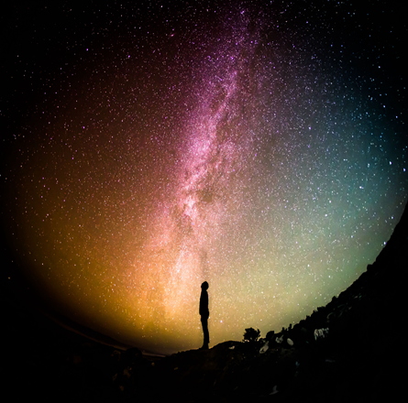
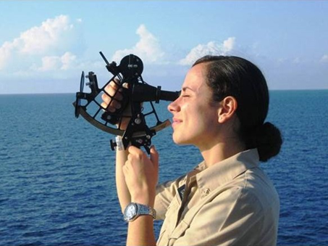
Identifying Stars
-Now that we know the time of SR/SS and Twilight based on our AP, we can begin to identify the best stars to use.
-We will need a minimum of 3, since we need 3 LOPs for a fix.
-The Nautical Almanac list the 57 best stars to use for CELNAV.
-We will not be able to see all of them from our position, so we have to narrow down our focus.
SEANAV I United States Naval Academy
NN220 – Fundamentals of Navigation
Operations Officer I HMS PROTECTOR A173 I The Ice Patrol Ship

Slide 14
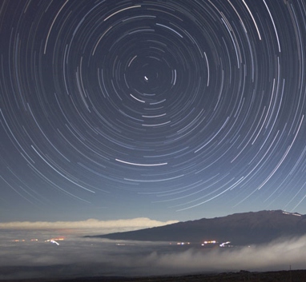
CELNAV Planning
We can predict the Declination and Greenwich Hour Angle (GHA) of any Celestial Body for a specific time using either the Nautical Almanac or STELLA. Remember that these are a CB’s coordinates on the Celestial Sphere!
Bearing 352°
Bearing 004°
Altitude of 48°
We convert these coordinates to relate to us on the Earth surface in terms of Azimuth and Altitude. This is done via STELLA or calculations using Strip Forms.
As CBs rise, their Altitude in relation to Visible Horizon increases and then decreases, just as with the Sun.
Altitude of 40°
Similarly, their Azimuth (True Bearing) also changes over time.
Visible Horizon
The further a Celestial Body is from the Celestial Pole, the higher its speed of relative motion and the more the Altitude and Azimuth will change over time.
Watch Video: https://www.youtube.com/watch?v=V97HQcbozeQ

Slide 15
CELNAV Planning
-The Altitude of a CB changes with Latitude.
-At the North Pole, we see Polaris at an Altitude of 90°. If we move further south, the Altitude will decrease until we go below the Equator and Polaris is no longer visible.
-GHA is the equivalent of Longitude on the Celestial Sphere. The GHA of a CB can be expected to change at approx. 15° per hour, just like our time zones on Earth.
-GHA is used to help us find the Azimuth at which we will see a CB, which will be based on the Time and Longitude of our AP.
-The relationship between our Longitude and GHA is called the Local Hour Angle (LHA).
SEANAV I United States Naval Academy
NN220 – Fundamentals of Navigation
Operations Officer I HMS PROTECTOR A173 I The Ice Patrol Ship

Slide 16
Celestial Navigation Planning
LHA is the difference between Longitude of the Observer at their AP and the GHA of a Celestial Body at a specific Time.
First Point of Aries GHA 192⁰
LHA is always measured westwards from Observer’s Longitude.
180⁰
LHA = GHA – West Longitude or GHA + East Longitude.
LHA
Rather than calculating our LHA in relation to each individual CB, LHA is normally based on the GHA of the First Point of Aries, as the reference point to the Stars.
090⁰W
090⁰E
AP(DR) Longitude 066⁰W
Using LHA and Publication 249 Sight Reduction Tables, we can immediately identify the best Stars to navigate from.
0⁰
Greenwich Mean Line

Slide 17

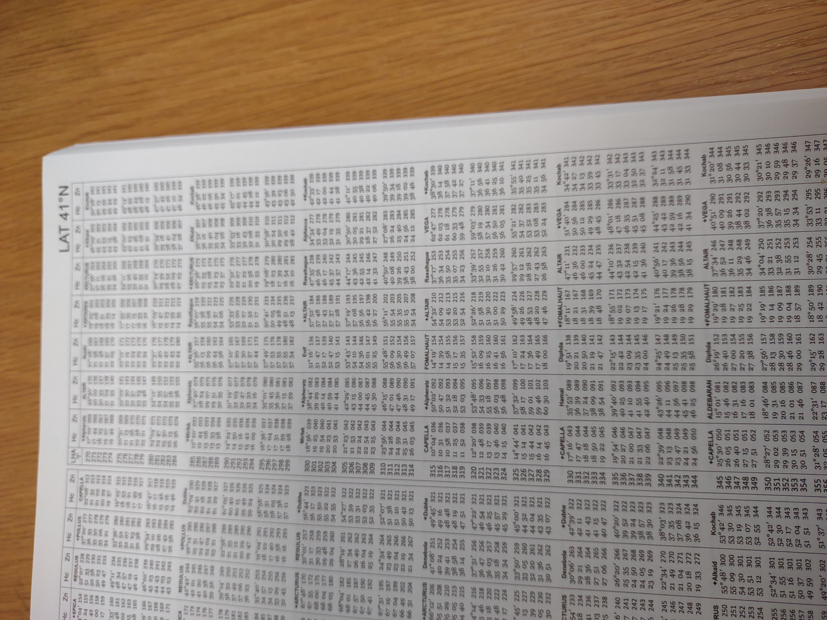

Identifying Stars
Using the Local Hour Angle (LHA) we can predict which Stars we will be able to see.
Latitude
Publication 249 – The Sight Reduction Tables is broken down into 3 Volumes. Volume 1 lists the 57 best stars, as detailed in the Nautical Almanac.
Local Hour Angle
Using our Latitude and the calculated LHA, we can enter the Publication and it will show us the 7 best stars based on our Assumed Position (AP), based on Magnitude (Brightness), Separation (at least 30° between CBs) and Altitude (between 20°-60°).
For each of the 7 stars it lists:
The Altitude or Height Calculated above the horizon.
The Azimuth or True Bearing we must look down.
It also highlights the best 3 stars for a fix.

Slide 18
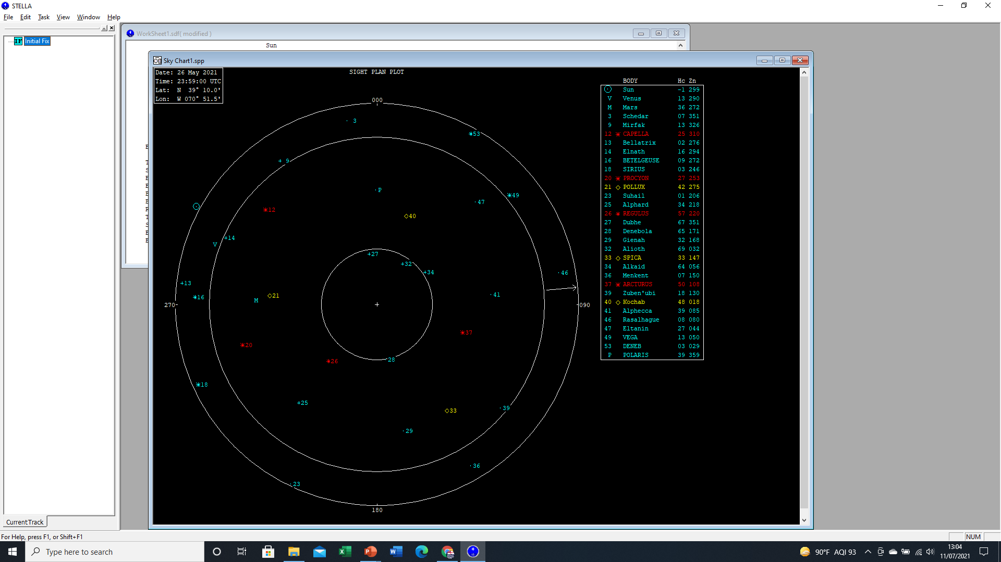
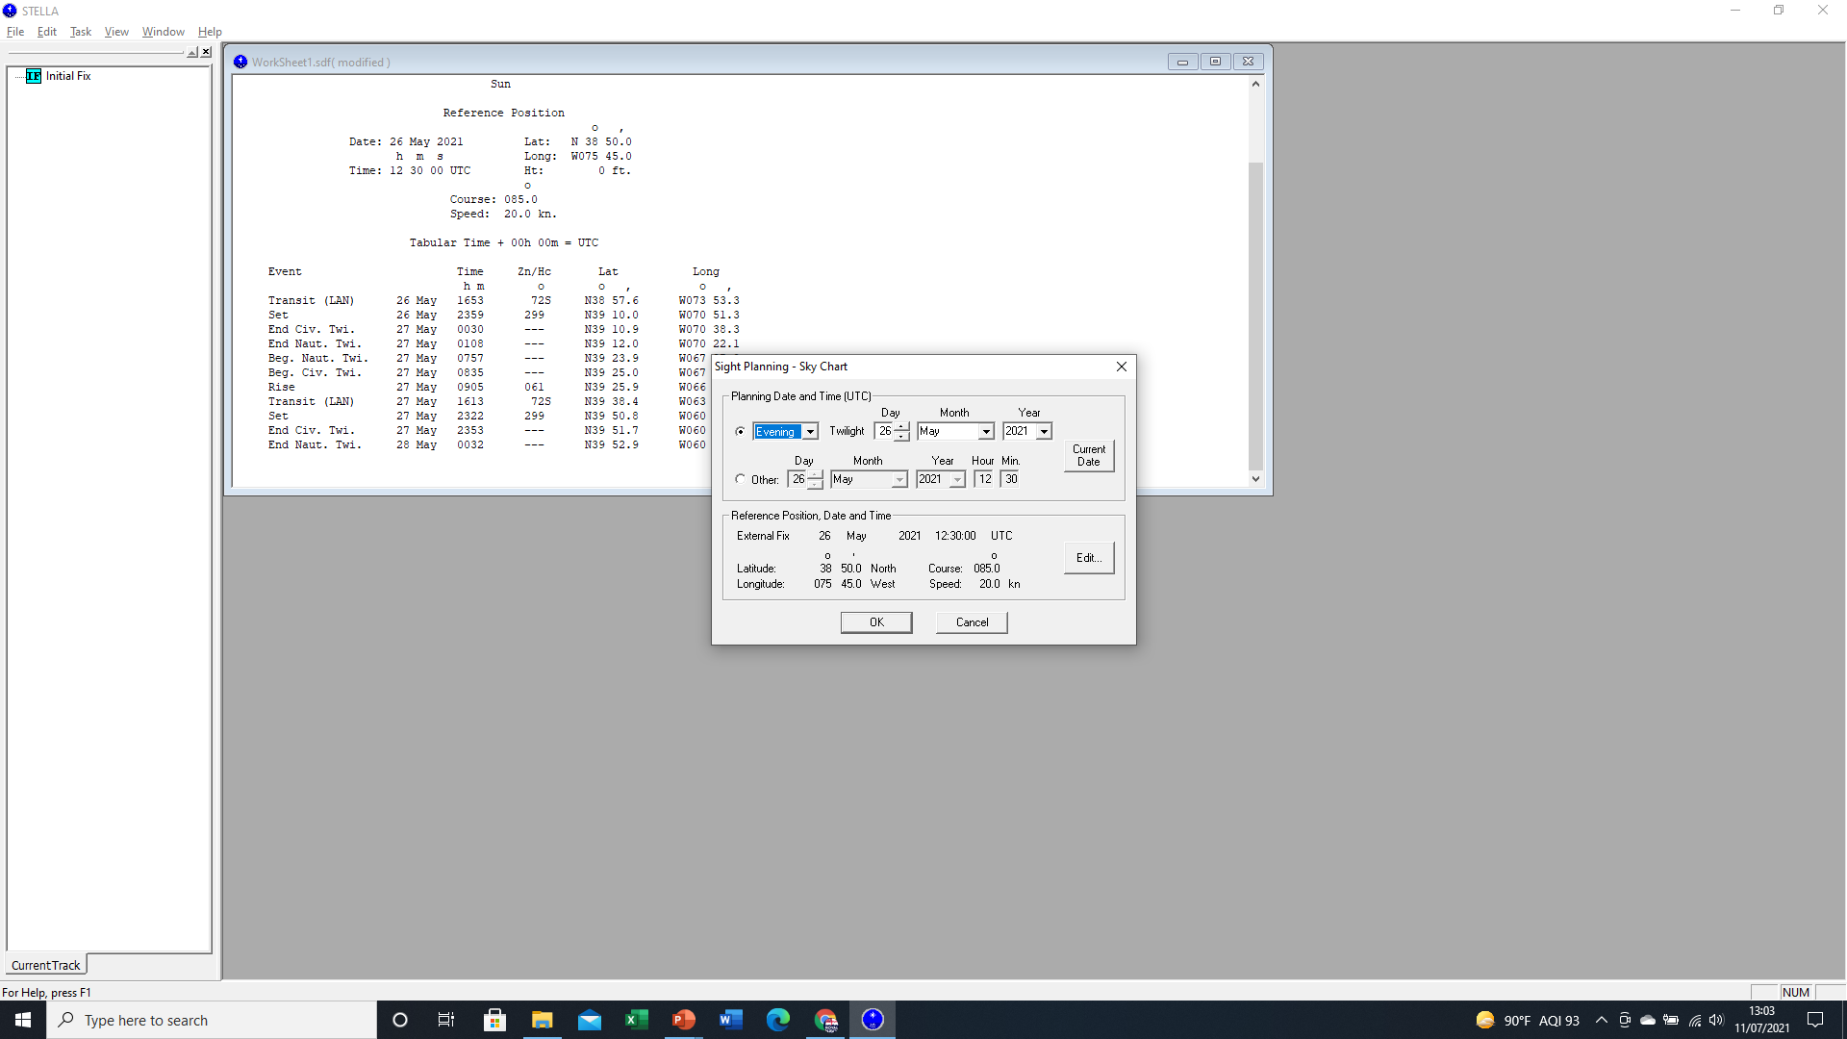
Identifying Stars
STELLA will also complete this function for us electronically.
List of Celestial Bodies, including Planets.
Time, Date and DR position (AP).
Based on our AP (DR), it will list the best Celestial Bodies to fix off of and present them on a Sky Chart.
The 7 best stars to use are highlighted in Red and Yellow.
However, sometimes, cloud can obscure the sky so we can’t always see the best stars. STELLA will display the Altitude and Azimuth of all stars of the 57 best navigable.
But remember, this is a snap shot for a specific Time in space. These objects are constantly moving, so their Altitude and Azimuth might be a little different based on the time we take the Sight.

Slide 19
Using the Stars
-So we have covered what we must do before we take sights:
Calculate our AP (DR) based on Initial Fix, Course, Speed and Time.
Calculate the Time of Sunrise/Sunset and Twilight based on our DR.
Identify which Celestial Bodies we are going to use, based on LHA, PUB 249 and/or STELLA. This will provide use with both the Altitude (Hc) and the Azimuth (Zn) of the best CBs from our AP.
Additionally, we must calibrate our Sextants, know our Height of Eye, Atmospheric Pressure and Temperature so that our Sight Reductions are accurate.
-We are almost ready to take sights!
-But first, let’s describe how we use the stars to create LOPs.
SEANAV I United States Naval Academy
NN220 – Fundamentals of Navigation
Operations Officer I HMS PROTECTOR A173 I The Ice Patrol Ship

Slide 20
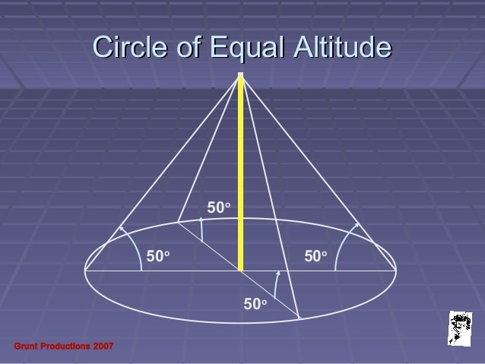
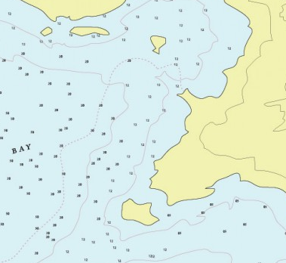
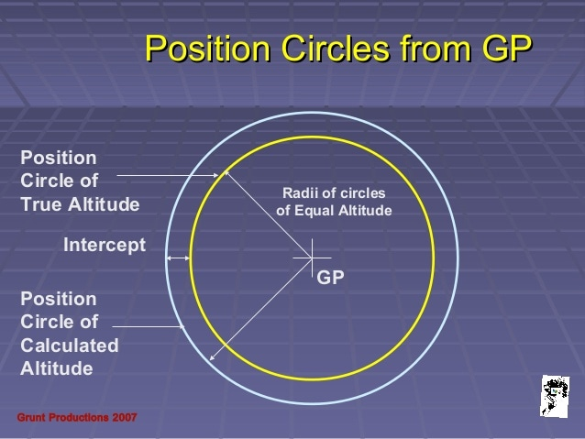
Circle of Equal Altitude
By taking a Sight, we are measuring the Altitude (Angle) of a Celestial Body between the Visible Horizon (0°) and our Zenith above us (90°).
Using the Math:
90° - Altitude = CO-ALTITUDE.
CO-ALT x 60nm = Distance (NM)
This gives us a distance from the Celestial Body’s Geographical Position on the Earth’s Surface. Like a radar range, we use it as an LOP.
However, the Altitude from a single object only tells us that we are on a circle of distance. Our position could be anywhere on that circle.
This is called a Circle of Equal Altitude and it is why we need at least 3 x LOPs in order to accurately fix our position.

Slide 21

Circle Of Equal Altitude
The Altitude of a Celestial Body is proportional to the Distance from it’s Geographic Position.
When we look up at 90°, our Zenith, if we see a Celestial Body above us we are at it’s Geographic Position.
Star / Celestial Body
As we move away from the GP, it’s Altitude in relation to us reduces.
When the Celestial Body’s Altitude dips below 0°, it has gone from the Horizon to beneath the Visible Horizon. We can no longer see it.
90° – Altitude = COALT
AP
(DR)
90° - 30° = 60°
30°
GP
60° x 60nm = 3600nm
3,600NM

Slide 22
Using the Stars
Once we have identified our preferred Celestial Bodies, we can take a minimum of 3 Sights. Generally, we take more just in case we misidentify a Star.
… A 3-point visual fix
GP1
GP3
GP2

Slide 23
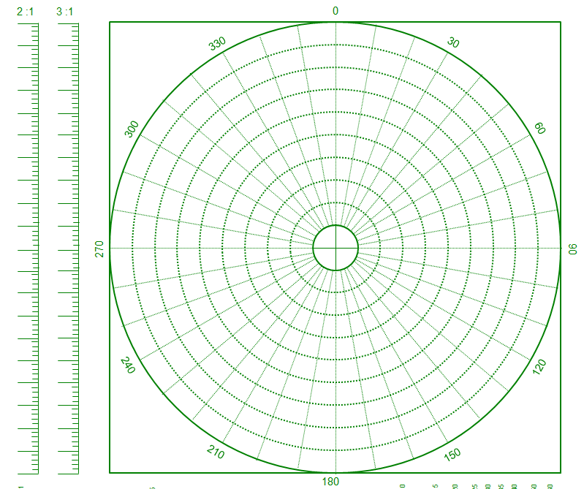
Using a MOBOARD, plot our AP as being at the center of the Board.
As a scale, each circle is equivalent to 300nm.
Now plot the position of Celestial Bodies Geographic Positions, in relation to us, based on their Height Calculated and Azimuth.
Kochab – HC = 48° / Azimuth 018°(T)
Based on an earlier fix, we have used STELLA to predict our Assumed Position (Dead Reckon) to get the predicted Height Calculated (Altitude) and Azimuth (True Bearing) of 3 Celestial Bodies on 26 May 2021 at 23:59Z.
Distance of the GP from the AP =
90-48 = 42° x 60nm
Pollux – HC = 42° / Azimuth 275°(T)
= 2520nm
AP
3000nm
2700nm
Distance of the GP from the AP =
90-42 = 48° x 60nm
2400nm
2100nm
1800nm
= 2880nm
Denebola – HC = 65° / Azimuth 171°(T)
1500nm
1200nm
Distance of the GP from the AP =
90-65 = 25° x 60nm
900nm
600nm
300nm
= 1500nm

Slide 24
Using the Stars
-When we have identified the preferred CBs to calculate our position, we will observe their actual Altitudes using a sextant.
-We take a minimum of 3 sights. Try to always take more if possible!
-The Altitude is the angle between the visible horizon and the CB. It will be a value between 0°-90°.
-We will then have the sights needed to calculate a fix.
SEANAV I United States Naval Academy
NN220 – Fundamentals of Navigation
Operations Officer I HMS PROTECTOR A173 I The Ice Patrol Ship

Slide 25
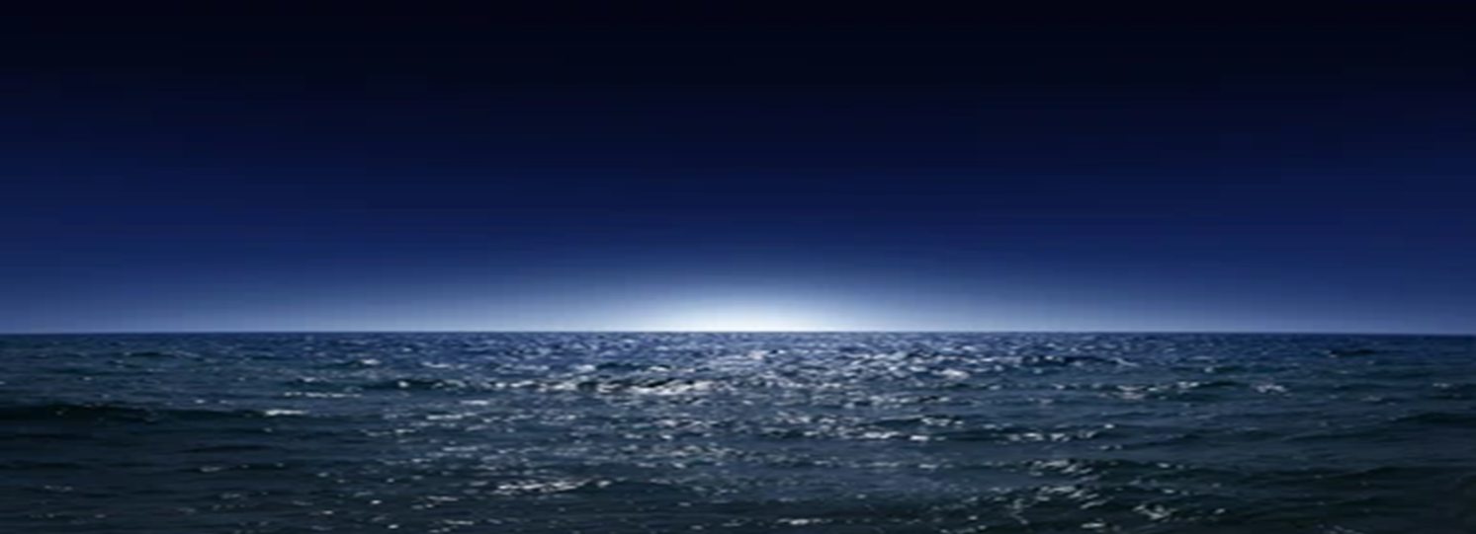
Using the Stars
-Rather than use the entire LOP circle, which can be enormous, we will only use a portion of it.
-What begins as a circle, is then viewed as a straight line that can be plotted onto a chart.
-How is this accomplished?
SEANAV I United States Naval Academy
NN220 – Fundamentals of Navigation
Operations Officer I HMS PROTECTOR A173 I The Ice Patrol Ship

Slide 26
Altitude Intercept Method
The Altitude Intercept Method again compares the Height Calculated, from STELLA or Pub 249, against the Height Observed.
But instead of relating the distances to the Geographic Position of a Celestial Body, it based entirely upon the Assumed Position.
The Azimuth (True Bearing) of the Celestial Body from the AP is predicted at 085°(T).
HC
The HC is 30° which equals a distance 3600nm between the GP and AP.
30°
GP
AP
Azimuth - 085
HC distance calculation =
90°-30° = 60°x 60nm =
3600nm

Slide 27
Altitude Intercept Method
We take a Sight of the Celestial Body using a Sextant, correcting for Index Error, Height of Eye, Barometric Pressure and Temperature to get Height Observed (HO).
The HO will be larger or smaller than the HC because our DR is very unlikely to be 100% accurate.
In this case, the Altitude or HO is 29.5° which is less than the HC by 0.5°.
HO distance calculation = 90°-29.5° = 30.5°x 60nm =
3630nm
HO
More easily, if 1° = 60nm then 0.5° difference between HC and HO = 30nm.
HC
If the HO is less than the HC, in terms of distance, we must be further away from the Geographic Position (GP) on a bearing opposite to the Azimuth.
30°
GP
29.5°
Azimuth - 085
AP
HC distance = 3600nm
HO distance = 3660nm
If HO is more than HC, we must be closer to the Geographic Position (GP) along the Azimuth.

Slide 28
Altitude Intercept Method
Right now however, we still have a circle.
We want to represent the circle as a straight line to make a usable LOP.
To do this, we draw a line perpendicular to the Azimuth of the Celestial Body from AP, at the new position.
Because HO was less than HC, this line is drawn on true bearing opposite to the Azimuth.
Perpendicular – line is drawn at 90° to Azimuth – therefore 355 to 175°
We now have a single line of position. Just as with a Circle of Equal Altitude, all we know is that we are somewhere on this line. We need 2 more lines to intersect for a 3 point fix.
GP
Azimuth - 085
AP
LOP
HO<HC therefore opposite to Azimuth - 265°(T) from AP.

Slide 29
Altitude Intercept Method
Hc = 66°
Ho = 66°30’
= 30NM toward GP
Hc = 70°
Ho = 69° 45’
= 15NMs away from GP
Hc
Hc = 44°
Ho = 45°
Hc
Hc
Ho
Ho
= 60 NMs toward GP
Ho
AP
Azimuth
Azimuth
15nm
GP
GP
30nm
Azimuth
GP

Slide 30
Plot our AP as being at the center of the Board.
As a scale, each circle is equivalent to 6nm.
Kochab – HC = 27° / Azimuth 048°(T)
HO = 27.05°
Pollux – HC = 42° Azimuth 275°(T)
HO 42.15°
Denebola
HC = 65°
Azimuth 171°(T)
HO = 64.8°
AP
60nm
Difference = 9nm
Toward as HO > HC
54nm
48nm
How far is our Fix from the Assumed Position?
42nm
Approximately 13nm. Not a bad update if the Ship hadn’t been able to fix in a few days!
36nm
30nm
24nm
18nm
12nm
6nm

Slide 31
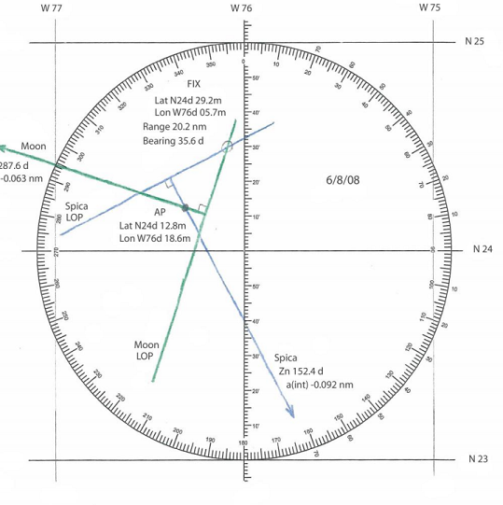
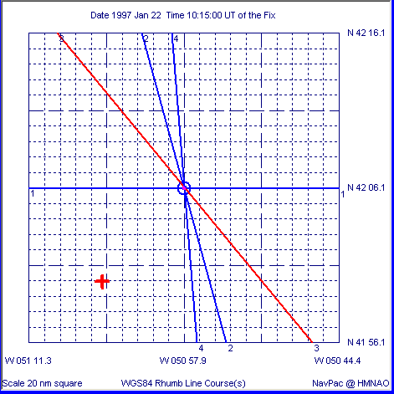
Altitude Intercept Method
Before STELLA, a Celestial Fix would be plotted on a Plotting Form manually using the Altitude Intercept Method.
Now, provided we input the right information, the system will plot and generate a Fix position for us to then update our Navigational Plot on ECDIS or a paper chart.
SEANAV I U.S. Naval Academy I Celestial Navigation
NN310 Advanced Navigation

Slide 32
CELNAV During the Day
-Using the stars, we can get a 3 point Celestial Fix twice a day, during the Twilight before Sunrise and the Twilight after Sunset.
-CELNAV doesn’t stop there.
-There are ways to calibrate equipment and fix a position during the day using CELNAV.
SEANAV I United States Naval Academy
NN220 – Fundamentals of Navigation
Operations Officer I HMS PROTECTOR A173 I The Ice Patrol Ship

Slide 33
Gyro Compass Error
-During the planning phase of CELNAV, we found the time of Sunrise and Sunset.
-Typically, we will also find the bearing of Sunrise and Sunset as well.
-The Sun rises in the East and sets in the West, but due to the effects of our Latitude and the Declination of the Sun, the exact bearing will change by a small amount.
-If we know the bearing of Sunrise or Sunset, we can take a bearing of it with our Gyro Compass and determine if an error exists.
SEANAV I United States Naval Academy
NN220 – Fundamentals of Navigation
Operations Officer I HMS PROTECTOR A173 I The Ice Patrol Ship

Slide 34
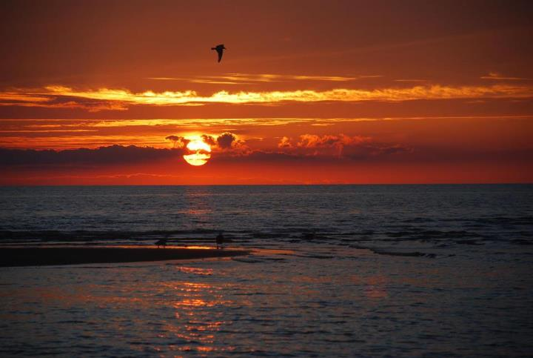
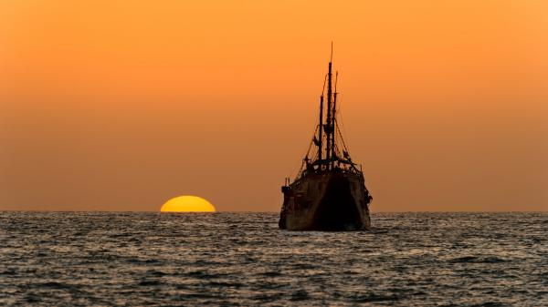
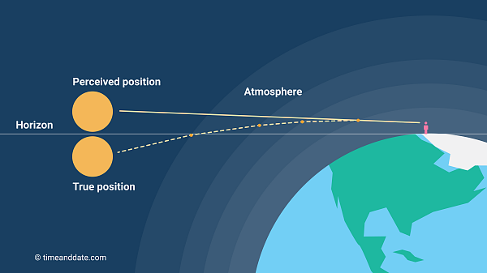
When the Sun is 12° below the Visible Horizon, it is the Start or End of Nautical Twilight.
Sunrise and Sunset
At Sunrise or Sunset, the Sun’s Apparent position is 34’ minutes (0.56° Altitude) or a ‘Semi Diameter’ above the Horizon.
So when exactly is Sunrise and Sunset?
When the sun’s light hits the atmosphere, the change in density causes the path of light to change.
When the Sun is 6° below the Visible Horizon, it is the Start or End of Civil Twilight.
Sun’s True Position at SR/SS is not visible above the horizon due to refraction.
The is therefore the Perceived Position of the Sun; where we see it.
Then there is the True Position of the Sun; where it is due to refraction.
6°
12°
True Sunrise or Sunset is when the Sun is at 34 minutes of Arc (Altitude) above the Visible Horizon. That is 0.56°
This position can also be described as a ‘Semi Diameter’ above the Horizon.

Slide 35
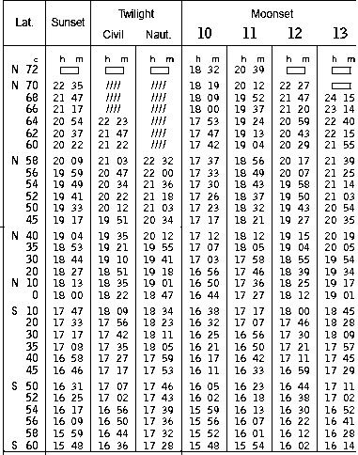
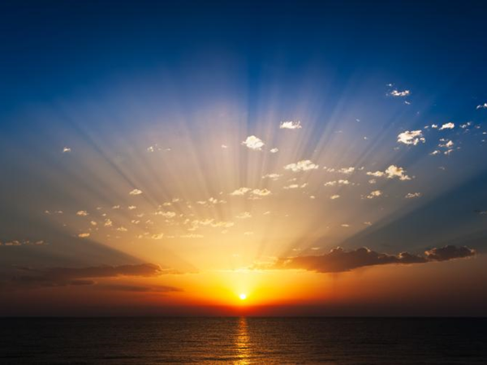
Sunrise and Sunset
To use Sunrise / Sunset we have to be able to calculate the time.
Time of Sunrise / Set
Listed in the Nautical Almanac
Tabulated for Latitude
Our DR Position is 40°N 76°W
Sunset time 40°N = 1904Z
Interpolate for
Own latitude
The correct day
Adjust for your longitude (Arc to Time)
Long = 76° W = 5Hr 04Min
West is Best so add to Sunset = 0008Z
Adjust for Time Zone +5R therefore subtract 5hrs = 1908R
Same process to predict Twilight/Moonrise/Moonset)

Slide 36
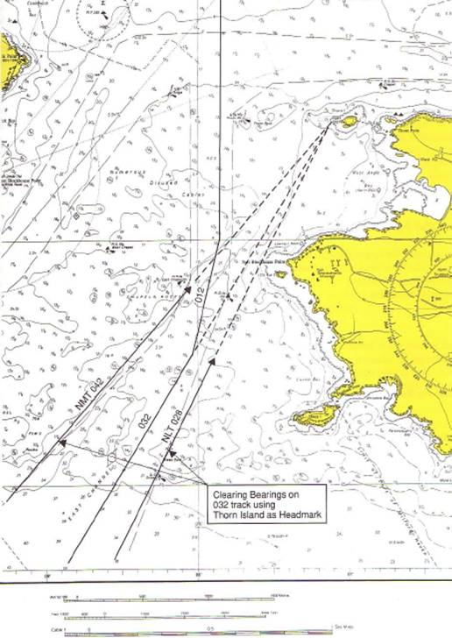

Bearing of Sunrise and Sunset
Once we have calculated the Time of SR / SS, we can calculate the bearing.
So why is this important? Especially when we don’t have GPS available, navigation and our weapon and sensor systems are reliant on accurate Gyro Compass inputs.
In aviation terms, 1° of heading error at 60nm will result in 1nm of error at destination.
Bears 033° @ 2nm
2 x 35 = 70yds per degree
1nm
1° Heading Error will result in a 1nm track error at 60nm
For Ships, using a navigation mark as a head bearing, 1° of error at 1nm is 35yds or 100ft. This can be used in navigation terms to assess track visually.
Our charted Head Bearing should be 032°. If it bears 033° we are left of track. 031° and we are right of track.
1° = 35yds at 1nm.

Slide 37
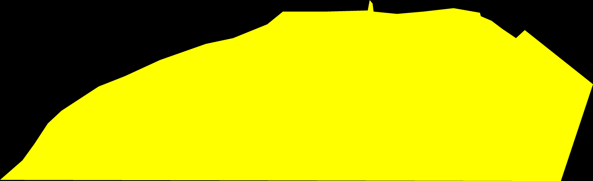
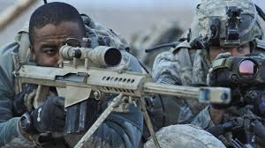
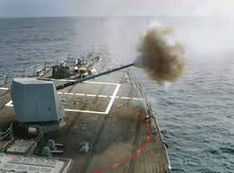

Bearing of Sunrise and Sunset
A more worrying example:
Our weapon systems find direction from the Ship’s gyro when no GPS input is available.
An Gyro error will impact weapon direction and targeting.
Loss of gyro means we can’t use our weapons in many cases.
SF Advanced Forces – “Call for Fire”
DDG is providing Naval Fires support 6 miles off the coast.
‘Call For Fire – Danger Close’ received against Enemy Position at 10nm from the Ship.
Ship has an unknown 2° East gyro error.
2° at 10nm = 700yds or 2000ft error placing friendly troops at risk!
Enemy Position

Slide 38
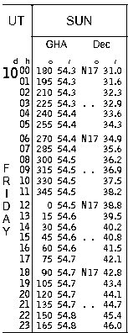
Bearing of Sunrise and Sunset
Bearing of Sunrise / Set
Sun’s Declination listed in the Nautical Almanac
Used to predict bearing of sun at SR/SS
Determine declination of Sun in GMT (UT)
Combine Declination and Latitude to ‘True Amplitude’
Angular distance from 090 or 270
Mathematically - TA - (Inv)Sin = Sin (Dec) / Cos (Lat)
Add/Subtract TA to get true bearing of SR/SS

Slide 39
Bearing of Sunrise and Sunset
Bearing of Sunrise / Set
E.g. Ship’s position 40°20’N 076°30’W
Time of Sunset 1908R (0008Z)
Declination of Sun N17° 31’.0
True Amplitude (North Dec > Add) Approx 23°
Bearing of Sun at SS 270 + 23°
= 293° (T)
Gyro at Sunset 292°
Gyro Error 1° East
*TA - (Inv)Sin = Sin (Dec) / Cos (Lat)
Don’t worry – STELLA has replaced the book!

Slide 40
Bearing of Sunrise and Sunset
Bearing of Sunrise / Set
Bearing of Sun Set 293° (T)
Gyro at Sunset 292° (PGC)
Gyro Error 1°E
Bearing taken by Gyro 292
Error = 1°E – we add 1° to any visual bearings or to weapon systems.

Slide 41
Video: Gyro Error with an Azimuth Circle
https://www.youtube.com/watch?v=NsGVSC94ztw

Slide 42
CELNAV During the Day
-After Sunrise when we conduct our first Gyro Compass error check, we can still conduct CELNAV.
-We can use the Sun to generate LOPs throughout the day.
-What kind of fix uses one NAVAID over a period of time to generate 3 LOPs?
SEANAV I United States Naval Academy
NN220 – Fundamentals of Navigation
Operations Officer I HMS PROTECTOR A173 I The Ice Patrol Ship

Slide 43
Using the Sun
DR
Running Fix based on DR
The Altitude of the Sun changes throughout the day.
Using math, 90°-ALT=COALT we can calculate our distance from the Sun’s GP during the day giving us an LOP.
We need 3 LOPs to get a good fix. However, the rate of movement of the Sun means that we need to leave time between each Sight in order to allow there to be a visible change.
Transferred Position Line from Morning
LOP based on our first position line in the Morning
New DR
By taking 3 Sights at different times during the day, we can take a Running Fix from the Sun provided that we take into account the Time, Course and Speed of the Ship.
Third Sight normally taken during the Afternoon.
Second Sight normally taken at Noon.
New DR
Transferred Position Lines

Slide 44
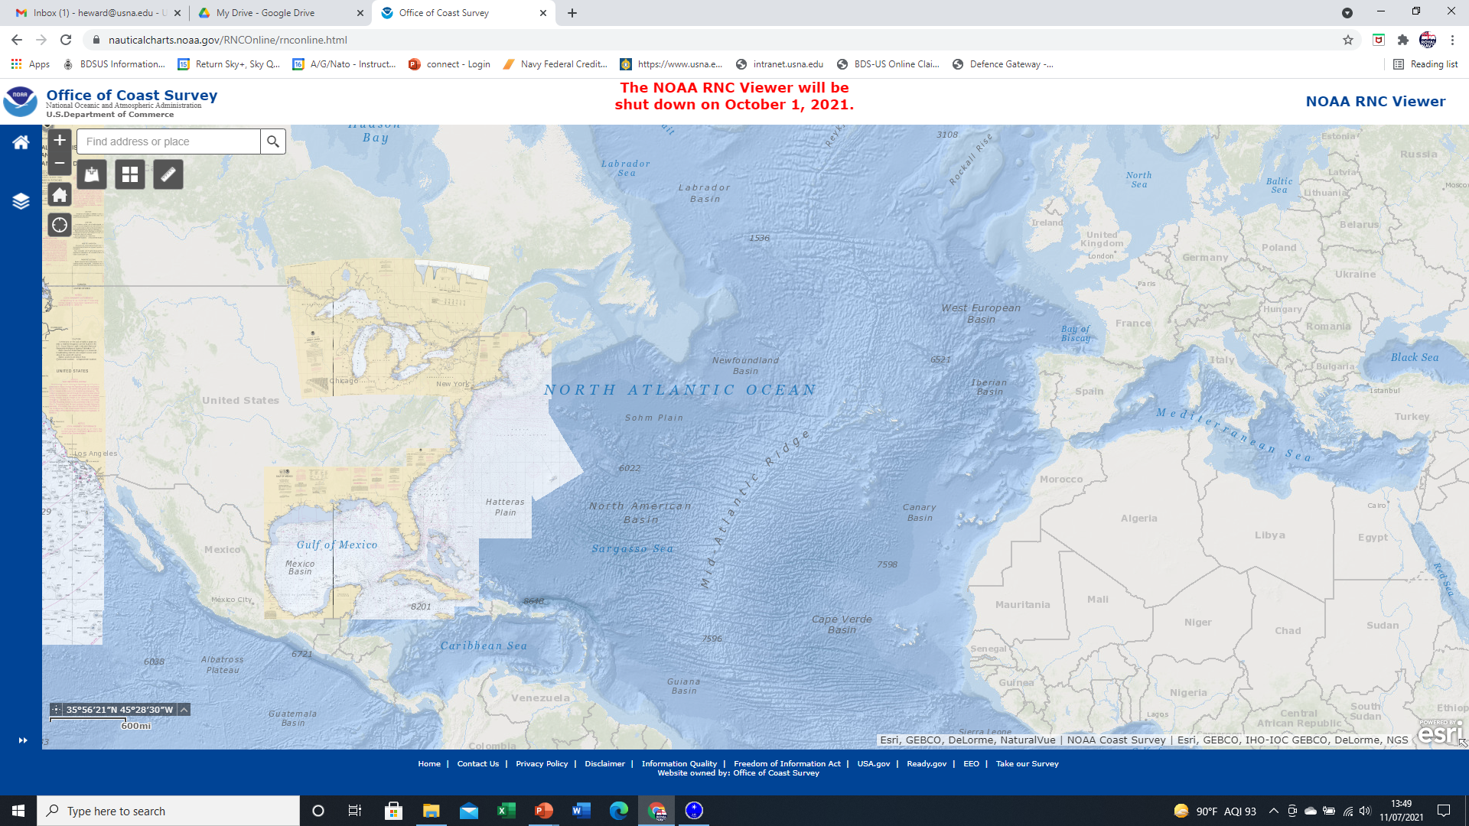
Sun – Run – Sun
Using a Running Fix and applying the principles of the Altitude Intercept Method, we can gain a fix during the day but just using the Sun.
Sun’s Geographic Position (GP).
Sun Rises in The East and Sets in the West.
The GP moves westerly with the Sun due to the Earth’ rotation.
1500Z
1206Z
1000Z

Slide 45
Sun – Run – Sun
Using a Running Fix and applying the principles of the Altitude Intercept Method, we can gain a fix during the day but just using the Sun.
Sun Sight taken during the Morning
The Height Observed at 1000Z = 52º 21.4’
What is the Co-Alt?
What is the distance?
90º - Alt = Co-Alt
37º 38.6’
Co-Alt x 60nm = 2258.6 NM

Slide 46
Sun – Run – Sun
Using a Running Fix and applying the principles of the Altitude Intercept Method, we can gain a fix during the day but just using the Sun.
Sun Sight taken at Noon
The Height Observed at 1206Z = 62º 37.7’
What is the Co-Alt?
What is the distance?
Co-Alt 27º 22.3’
1642.3 NM
Lat 50º 49.1’

Slide 47
Sun – Run – Sun
Using a Running Fix and applying the principles of the Altitude Intercept Method, we can gain a fix during the day but just using the Sun.
The Height Observed at 1500Z = 46º 50.5’
What is the Co-Alt?
What is the distance?
Co-Alt 43º 09.5’
2589.5 NM

Slide 48
CELNAV During the Day
-While using the Sun-Run-Sun method to determine our position, we take three sights of the Sun throughout the day.
-The 2nd Sun LOP has some additional significance, as it is taken during Local Apparent Noon (LAN), or when the Sun crosses our Meridian.
SEANAV I United States Naval Academy
NN220 – Fundamentals of Navigation
Operations Officer I HMS PROTECTOR A173 I The Ice Patrol Ship

Slide 49
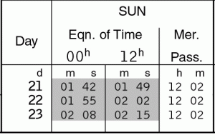
Meridian Passage / Local Noon
The time of MERPASS varies based on the Sun’s Declination and our Longitude.
The Nautical Almanac lists the time of MERPASS at Greenwich.
The Time of MERPASS changes by 4 mins every 1° of Longitude.
50º 30’N
DR Longitude
Mer Pass 1248
50º 00’N
1250
1246
1242
1238
49º 30’N
011º W
010º W
009º W
008º W

Slide 50
Meridian Passage / Local Noon
By taking a Sight at Meridian Passage, we can gain not only our distance from the Sun’s GP but we can also calculate our Latitude.
Observer’s
Meridian
Zenith
Co-altitude
Declination (from N.A.)
By calculating our Co-Alt from the Sight, and then adding or subtracting the Sun’s Declination, we can calculate Latitude.
Pole
Latitude
Altitude
E
N
S
Observer’s Horizon
W
Equator

Slide 51
Meridian Passage / Local Noon
Zenith
Latitude 40°N
Equator
Pole
Co-Alt
Dec N20 °
True Altitude
Observer’s Horizon
When Latitude and Declination are in same hemisphere and Lat is > Dec
Latitude = Declination + Co-Altitude

Slide 52
Meridian Passage / Local Noon
Zenith
Latitude
Equator
Pole
Dec
Co-Alt
Observer’s Horizon
True Altitude
When Latitude and Declination are in opposite hemispheres
Latitude = Co-Altitude - Declination
52

Slide 53
Day’s Work in Celestial Navigation
Now that we have explored the different ways in which to Fix the Ship’s Position to prove equipment correct, how do we execute this on a transit across the Atlantic?
CELNAV is a Team game – Each Watch needs to have the basic knowledge to be able to execute the CELNAV task that relates to their Watch.
Morning Stars
Taken between Nautical Twilight and Sun Rise
3 Point Fix by LOP
Sunrise
34’ of Arc / Sun Semi Diameter above horizon
Gyro Check
Morning
Take Sight of Sun’s Altitude
Gain 1 LOP
Local Noon
Take Sight of Sun’s Altitude
Second LOP and Latitude
Afternoon
Take Sight of Sun’s Altitude
Third LOP – complete running fix
Sunset
34’ of Arc / Sun Semi-Diameter above horizon
Gyro Check
Evening Stars
Taken between Sunset and Nautical Twilight
3 Point Fix by LOP

Slide 54
Enabling Objectives
1 – DESCRIBE The planning involved to conduct CELNAV. 2 - DEFINE Local Hour Angle in relation to identifying Celestial Bodies (CBs). 3 - DESCRIBE Dead Reckoning and relationship of Assumed Position (AP) to Time. 4 - EXPLAIN How to identify the best CBs to navigate from. 5 - EXPLAIN Circle of Equal Altitude. 6 - DESCRIBE The Altitude Intercept Method. 7 - DEFINE Sunrise / Sunset in relation to the Visible Horizon. 8 - DESCRIBE The importance of accurate Gyro Compasses and effect on Navigation / Weapon Systems. 9 - EXPLAIN How to calculate Gyro Error from the bearing of Sunrise / Sunset. 10 - DESCRIBE How to fix from the Sun using a Running Fix (Sun Run Sun). 11 - DESCRIBE Meridian Passage and the calculation of Latitude. 12 - DESCRIBE The Day’s Work in Celestial Navigation.
SEANAV I United States Naval Academy
NN220 – Fundamentals of Navigation
Operations Officer I HMS PROTECTOR A173 I The Ice Patrol Ship

Slide 55

Questions?
SEANAV I United States Naval Academy
NN220 – Fundamentals of Navigation
Operations Officer I HMS PROTECTOR A173 I The Ice Patrol Ship

